Slide 1
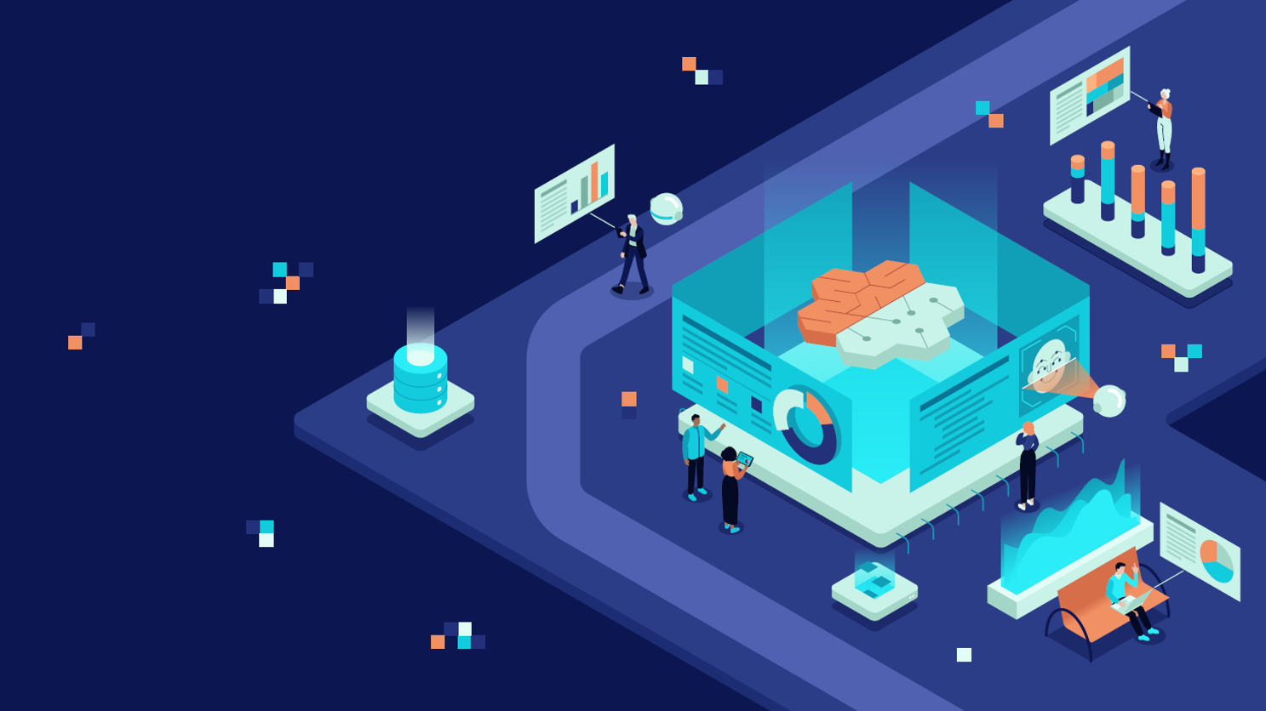
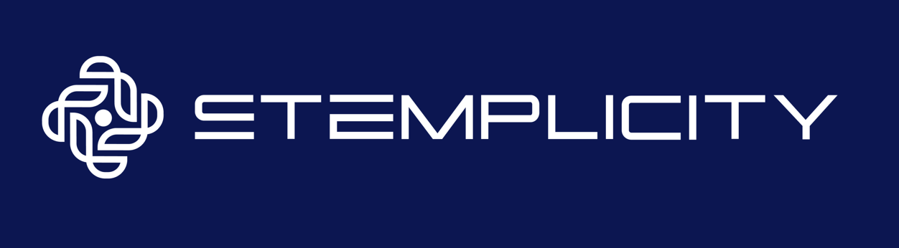
BUILD A CHARACTER AI CHATBOT USING OPENAI API

Slide 2

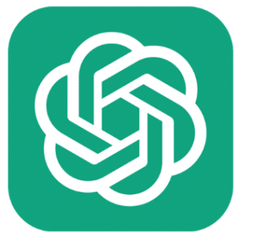
Project Overview
In this project, we will build a "Character AI Chatbot" using OpenAI API.
Imagine being able to chat with a grumpy pirate, a fancy Shakespearean writer, or any personality you can dream up!
Model Output
AI Character:
Sherlock Holmes
Ah, my dear! I am engaged in the meticulous examination of some rather intriguing cases that require the sharpness of my intellect and the powers of deduction I employ so frequently.
© All rights reserved for Dr. Ryan Ahmed @Stemplicity Inc.
OpenAI API
User Prompt:
What are you up to today?

Slide 3

Key Learning Outcomes
Learn how to configure OpenAI API and set your API key.
Communicate with powerful AI models like OpenAI’s GPT using their APIs.
Discover how to guide the AI’s behavior using "System Prompts," which represent special instructions that shape how the AI responds.
Understand the concept of “Tokens” in Large Language Models
© All rights reserved for Dr. Ryan Ahmed @Stemplicity Inc.

Slide 4

Summary
Generative AI allows machines to create new content such as text, images, and code by learning from patterns in data.
Using the OpenAI API, you can easily develop intelligent AI-powered applications.
By customizing the system message, you can guide the AI’s tone, behavior, and personality to fit your use case.
OpenAI provides a variety of models that differ in performance, reasoning ability, and cost, giving you the flexibility to choose the best fit for your project.
© All rights reserved for Dr. Ryan Ahmed @Stemplicity Inc.

Slide 5
Thank you!

